Slide 1

UBER DATA ANALYSIS
GROUP 1
Abinab Nag
Ranjan Ghosh
Priya Chakraborty
Tsheringma Tamang
Rupa Sharma

Slide 2
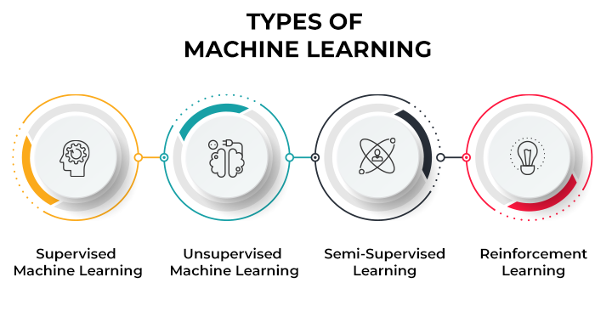
MACHINE LEARNING
Machine learning (ML) is a type of artificial intelligence (AI) that allows software applications to become more accurate at predicting outcomes without being explicitly programmed to do so. Machine learning algorithms use historical data as input to predict new output values.
Machine learning is important because it gives enterprises a view of trends in customer behavior and business operational patterns, as well as supports the development of new products. Many of today's leading companies, such as Facebook, Google and Uber, make machine learning a central part of their operations. Machine learning has become a significant competitive differentiator for many companies.

Slide 3

INTRODUCTION
Uber is a transportation company with an app that allows passengers to hail a ride and drivers to charge fares and get paid. More specifically, Uber is a ridesharing company that hires independent contractors as drivers. It's one of many services today that contribute to the sharing economy, supplying a means of connecting existing resources instead of providing the physical resources themselves. Uber is an international company located in 69 countries and around 900 cities around the world.

Slide 4


PROBLEM STATEMENT
Uber is an international company located in 69 countries and around 900 cities around the world. Lyft, on the other hand, operates in approximately 644 cities in the US and 12 cities in Canada alone. However, in the US, it is the second-largest passenger company with a market share of 31%.
How does Uber price work?
Why are Uber rates changing?
How many times have I traveled in the past?*
How many trips were completed and canceled?*
What a measure. fare, distance, amount, and time spent on the ride?*

Slide 5
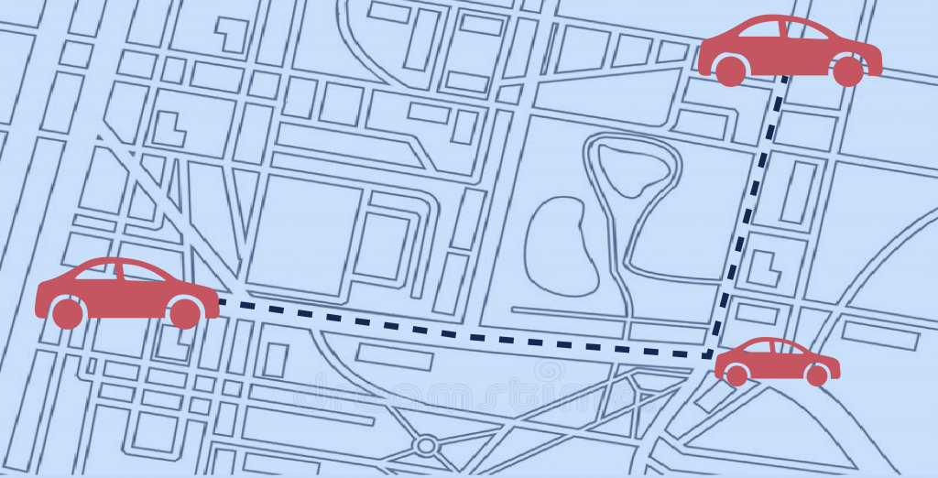
CHALLENGES
Finding the best regression algorithm, among Linear Regression for our problem was a challenge.
Collecting meaningful data.
With the high volume of data available for businesses, collecting meaningful data is a big challenge.
Selecting the right analytics tool.

Slide 6
LIBRARIES USED
import warnings
Warning messages are typically issued in situations where it is useful to alert the user of some condition in a program, where that condition (normally) doesn’t warrant raising an exception and terminating the program.
import numpy
NumPy is a Python library used for working with arrays. It also has functions for working in domain of linear algebra, fourier transform, and matrices.
import pandas
Pandas is a game changer, and it is one of the most popular and commonly used tools in data analytics. Pandas is that it takes data from a CSV or TSV file or a SQL database and generates a Python object with rows and columns called a data frame, which looks remarkably similar to a table in statistics tools like Excel. Working with this is far more convenient than dealing with lists and/or dictionaries.
import matplotlib
Matplotlib is a python library used to create 2D graphs and plots by using python scripts. It has a module named pyplot which makes things easy for plotting by providing feature to control line styles, font properties, formatting axes etc.

Slide 7
LIBRARIES USED
import seaborn
The import seaborn portion of the code tells Python to bring the Seaborn library into your current environment. The as sns portion of the code then tells Python to give Seaborn the alias of sns. This allows you to use Seaborn functions by simply typing sns.function_name rather than seaborn.function_name.
from sklearn.model_selection import train_test_split
The Sklearn train_test_split function splits a dataset into training data and test data.
from sklearn.preprocessing import StandardScaler
StandardScaler removes the mean and scales each feature/variable to unit variance. This operation is performed feature-wise in an independent way. StandardScaler can be influenced by outliers (if they exist in the dataset) since it involves the estimation of the empirical mean and standard deviation of each feature.
from sklearn.linear_model import LinearRegression
Linear regression is a statistical method for modeling relationships between a dependent variable with a given set of independent variables.
from sklearn.feature_selection import RFE
The model used for RFE could vary based on the problem at hand and the dataset. Popular models that could be used include Linear Regression, Logistic Regression, Decision Trees, Random Forests and so on.

Slide 8
LIBRARIES USED
from sklearn.feature_selection import RFE
The model used for RFE could vary based on the problem at hand and the dataset. Popular models that could be used include Linear Regression, Logistic Regression, Decision Trees, Random Forests and so on.
from sklearn.metrices import r2_score
The sklearn. metrics module implements several loss, score, and utility functions to measure classification performance. Some metrics might require probability estimates of the positive class, confidence values, or binary decisions values.
from sklearn.metrices import mean_square_error
The Mean Squared Error (MSE) or Mean Squared Deviation (MSD) of an estimator measures the average of error squares i.e. the average squared difference between the estimated values and true value. It is a risk function, corresponding to the expected value of the squared error loss.

Slide 9

SoLUTIoN APPRoACH
Step 1: "uber_Data.csv" dataset was taken from uber.com and was reconﬁgured to reﬂect the important features.
Data frames in which we loaded the dataset now include the Selling price , Present price, Kms driven, owner, age, Fuel Type, Seller type, Transmission type.
Step 2: Categorical features were then converted to numerical values.
We remove multiple columns of the dataset using the get_dummies function as some columns contain the same information because the original column could assume a binary value, The "CNG" fuel type, the "Automatic" transmission type, and the "Dealer" seller type were removed.
Step 3: We created a heat map using Pearson correlation to illustrate how the features are related.

Slide 10

SoLUTIoN APPRoACH
Step 4: Using ExtraTreesRegressor the feature importances were obtained. And Present_Price turned out to be the feature with most importance.
We used Random Forest Regression to solve the problem and created a model based on this.
Step 5: By using randomizedsearchCV, we performed hyper parameter tuning
(n_estimators, max_features, max_depth, min_samples_split, min_samples_leaves).
Due to its speed, RandomizedSearchCV is better than GridSearchCV.
Step 6: The data has been split into training data (80%) and test data (20%).

Slide 11
SoLUTIoN APPROACH
Step 7: After getting the best parameters from the RandomizedSearchCV we train the model using the Random Forest Regression .
In the random forest regressor, the decision tree will scale the input, so we do not have to scale the values.
The graph of predictions is plotted using displot/ distplot in which we observe that it resembles a normal distribution with mean 0.
Step 8 : The ﬁle is put in a pickle ﬁle. Also the performances of the model are computed.
Step 9 : The model is demonstrated by entering features in an HTML ﬁle and predicting the price by using a Python ﬁle from the set of values given as features.
Lastly, the ﬁnal output is displayed on the HTML page.

Slide 12

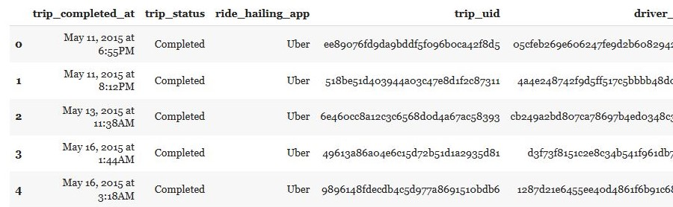
DATASET
The data we have used in this project was in csv.file. It was taken from uber.com . The dataset consists of 678 rows and 45 columns with no null values. Column data consist of independent Features. The independent features contain both categorical and numeric values.

Slide 13
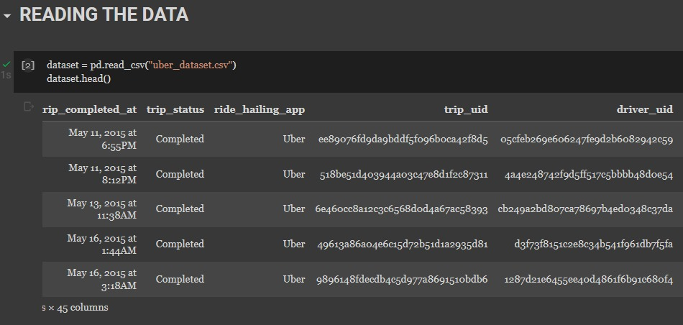
DATA READING
It is the data that we need to load for starting any of the ML project. With respect to data, the most common format of data for ML projects is CSV (comma-separated values). Basically, CSV is a simple file format which is used to store tabular data (number and text) such as a spreadsheet in plain text.

Slide 14
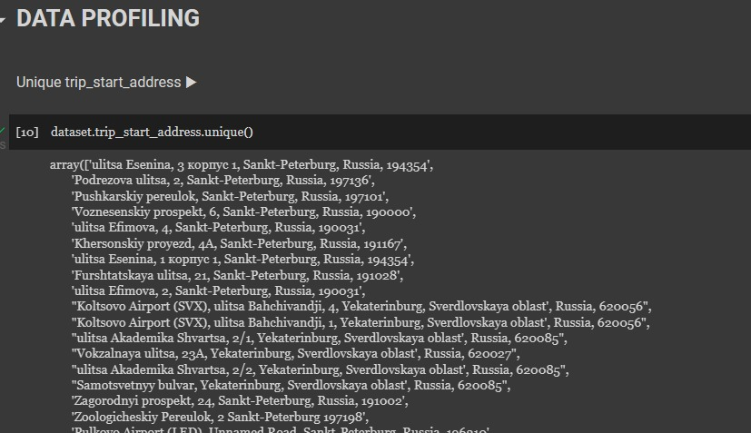
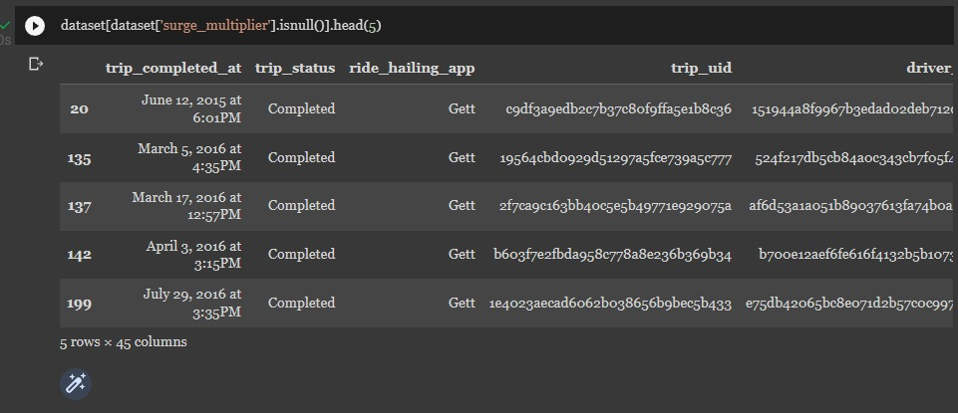
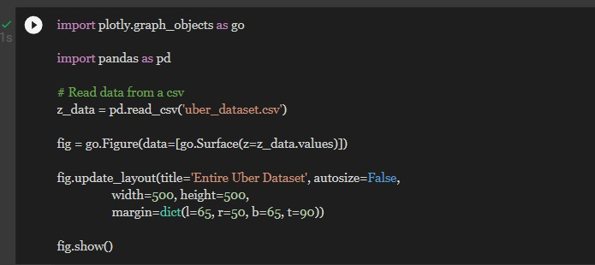
DATA MANIPULATION
Data manipulation is the process of changing data to make it easier to read or be easier to process.

Slide 15
DATA CLEANING
Data cleansing is essential because, regardless of how sophisticated your ML algorithm is, you can't obtain good results from bad data.

Slide 16
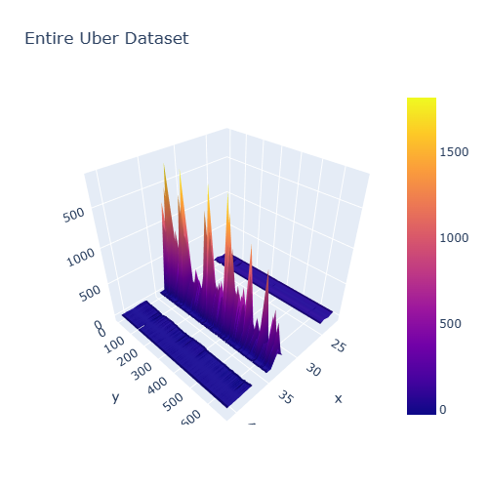
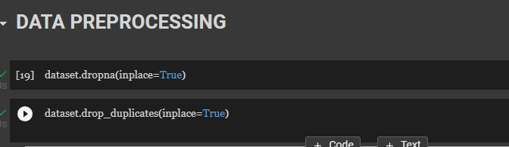
DATA PROCESSING
Data Processing is the task of converting data from a given form to a much more usable and desired form i.e. making it more meaningful and informative.

Slide 17
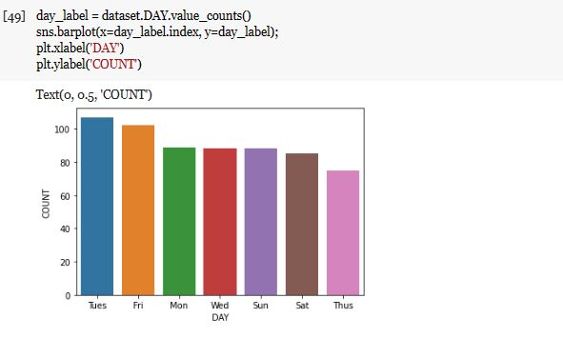
DATATIME OPERATION
The DATETIME type is used for values that contain both date and time parts. MySQL retrieves and displays DATETIME values in ' YYYY-MM-DD hh:mm:ss ' format

Slide 18
DATATIME PROFILING
Data profiling is a technique used to analyze and gain a better understanding of raw data.

Slide 19
DATA VISUALIZATION
Data visualization is a graphical representation of quantitative information and data by using visual elements like graphs, charts, and maps.

Slide 21
OBSERVATION
In this project,
we have used uber csv file to analyize uber data.
We have used libraries like pandas, numpy, seaborn, matplotlib to manipulate the data.
From where we can see how the company is performing and it is easy to understand by plotting the graphs.

Slide 22
RESULTS

Slide 23
CONCLUSION
Uber uses a mixture of internal and external data to estimate fares. Uber calculates fares automatically using street traffic data, GPS data and its own algorithms that make alterations based on the time of the journey. It also analyses external data like public transport routes to plan various services.

Slide 24

THANK YOU!
Git Hub LInk
CREDITS: This presentation template was created by Slidesgo, including icons by Flaticon, and infographics & images by Freepik and illustrations by Stories

